Slide 1
CalDataViewer for viewing calculated band structure
Program by Teng Zhang, latest edit 04/July/2015
Guidebook by Shuzhan Sun, 18/Aug/2015
Oxford, Chen’s Group

Slide 2
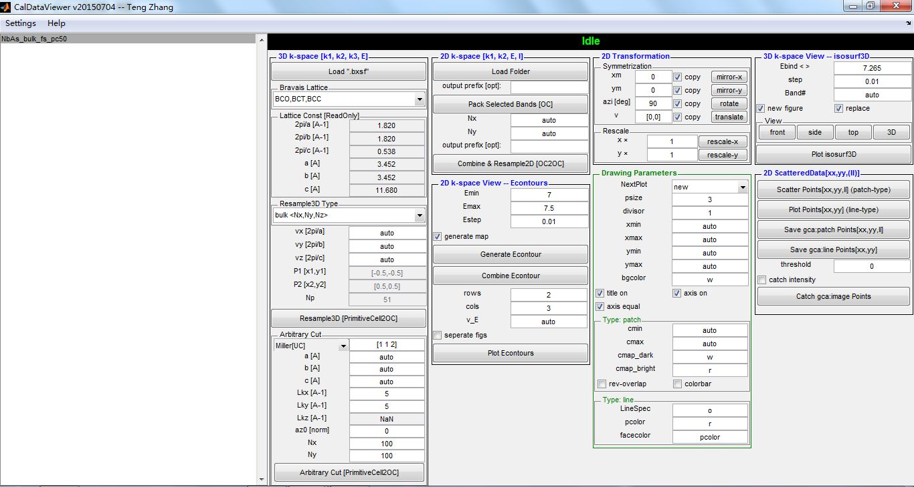
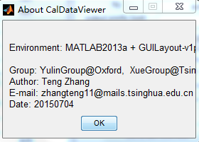
GUI Program: CalDataViewer.m

Slide 3
3D
Take NbAs(BCT) as example

Slide 4
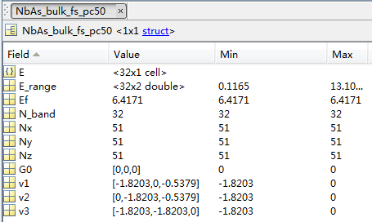
Raw Information in calculated data ‘.bxsf’ files
Variable name (same as file name)
E(k1,k2,k3) (32 bands here)
Fermi energy
Dividing point numbers of base vectors
G point
Base vectors of first BZ
Only band structure of first BZ is provided

Slide 5
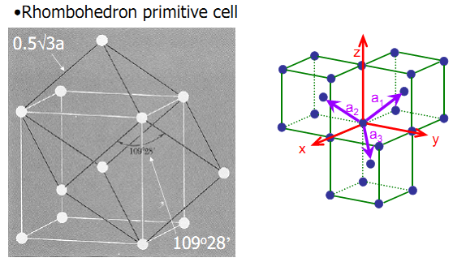
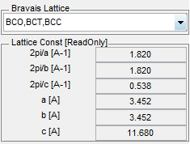
Lattice Information
c
a
b
Automatically read from calculated data
abbreviations in this GUI
UC : unit cell (white cell above)
PC : primitive cell (black cell above)
OC : orthogonal coordinate

Slide 6
What is Resample 3D
Raw band structure is E(k1,k2,k3) in a 3D grid, point (k1,k2,k3) means k1*v1+k2*v2+k3*v3, where v1,v2 and v3 are base vectors of first BZ
During resample, the GUI first interpolates raw band structure, then calculates band structure in a new grid (in orthogonal coordinate) and outputs data

Slide 7
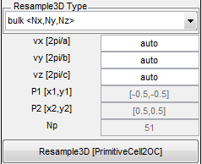

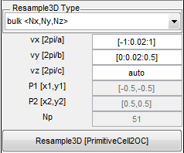
Resample 3D_bulk<Nx,Ny,Nz>
3D grid vx*vy*vz in orthogonal coordinate
2pi/a as unit length of vx (cautious)
Default bulk grid: vx= linspace(-0.5,0.5,Rawdata.Nx)
vy=linspace(-0.5,0.5,Rawdata.Ny)
vz=linspace(-0.5,0.5,Rawdata.Nz)
Set like ‘[start:dx:end]’
Raw data (same name with file)
Self set data (set as left)
Default data (set ‘auto’ )

Slide 8
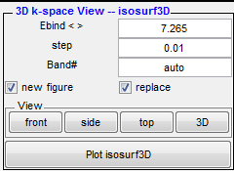
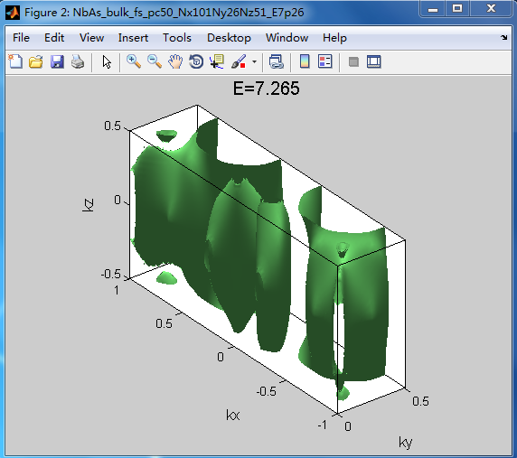
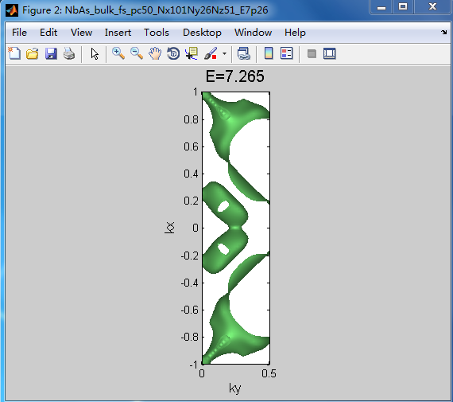
View-isosurf3D Only for ‘Resample 3D_bulk<Nx,Ny,Nz>’ data
Draw equal energy surface, use build-in function ‘isosurface’
Equal energy (small tip: press up/down to change equal energy)
Changing step of equal energy
Band_No to be drawn in one picture (default all bands, set as ‘[start:dx:end]’ )
1) choose resample 3D bulk data
2) click on ‘Plot isosurf3D’
3) change view (right are 3D and top)

Slide 9
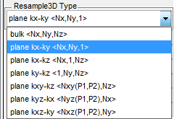
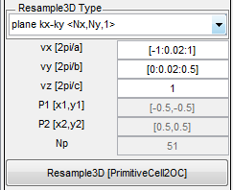
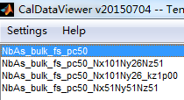
Resample 3D_plane kx-ky<Nx,Ny,1>
2D grid vx*vy in orthogonal coordinate
Default grid:
vx= linspace(-0.5,0.5,Rawdata.Nx)
vy=linspace(-0.5,0.5,Rawdata.Ny)
vz=linspace(-0.5,0.5,Rawdata.Nz)
3) Length(vz) must be reset as 1
Similar with bulk
Kz1p00 means kz=1.00, ‘p’ replaces ‘.’

Slide 10
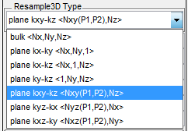
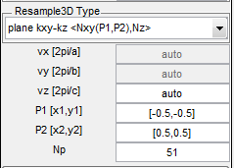
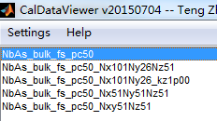
Resample 3D_plane kxy-kz<Nxy(P1,P2),Nz>
2D grid [P1,P2]*vz in orthogonal coordinate
Default grid:
[P1,P2]=linspace(P1,P2,Np)
vz=linspace(-0.5,0.5,Rawdata.Nz)
2pi/a as unit length of x1 and x2,
2pi/b as unit length of y1 and y2,
2pi/c as unit length of vz
Nxy is Np

Slide 11
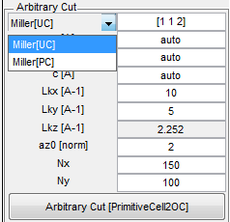
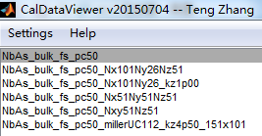
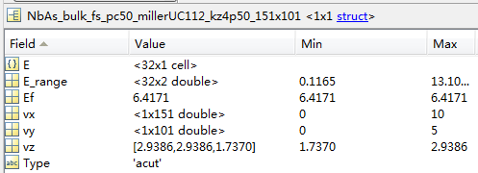
Arbitrary Cut (for raw data only)
UC: unit cell
PC: primitive cell
Kz4p50 means kz=4.50,
‘p’ replaces ‘.’
2D grid vx*vy in cut surface
Linspace(0,Lkx,Nx)*linspace(0,Lky,Ny)

Slide 12
2D
Take NbAs(BCT) as example

Slide 13
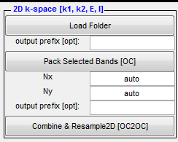
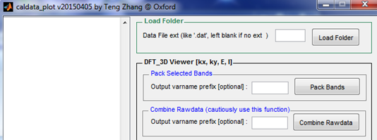
2D k-space [k1, k2, E, I]
For DFT data
Useless to ‘.bxsf’ data here!
Previous program ‘DFT Data Viewer ’ by Teng Zhang
Similar function, so I just quote Teng’s guidebook to demonstrate this part.

Slide 14
DFT Data Format
Quote from Teng
(1)DFT 3D -- For drawing contours at different energy (including Ef)
File Name: band_xxx
Data Format: [kx ky E proj] 4 columns, scattered points.
(2)DFT 2D -- For drawing cuts along different directions of high symmetry
File Name: *.dat
Data Format: [k E proj] 3 columns, scattered points

Slide 15
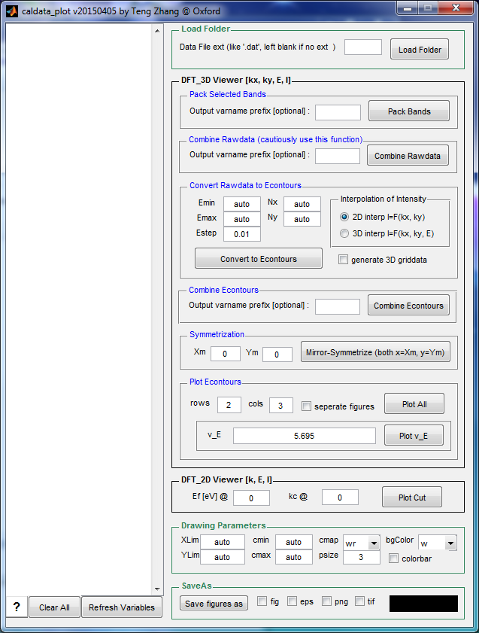
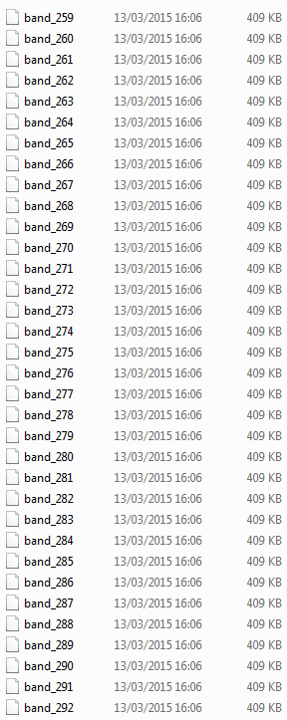
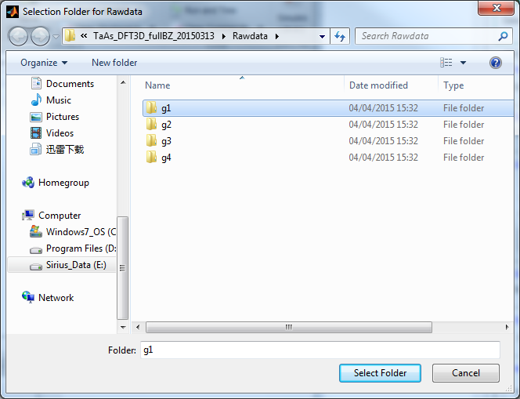
Load band_xxx
Quote from Teng
Left blank since band_xxx has no extension

Slide 16
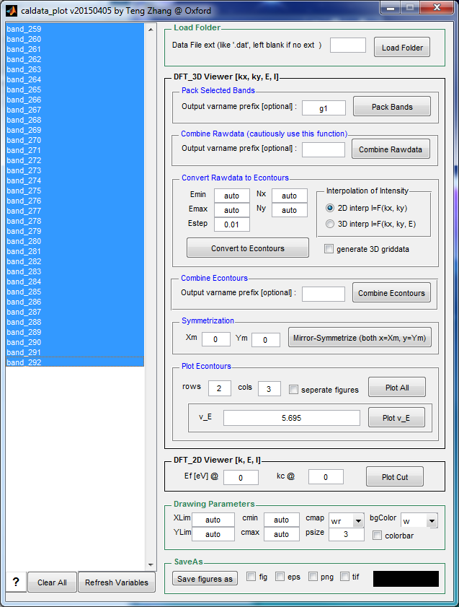
Pack Selected bands
Quote from Teng
give a prefix ‘g1’(use any label you like) for the output varname.
Notice that the variable will be overwritten for same varname.
We choose all the bands loaded in this demo.

Slide 17
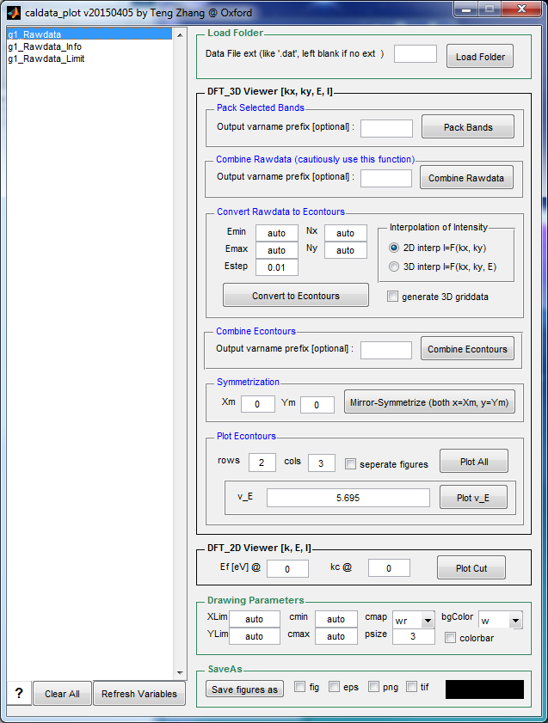
Quote from Teng
The program will generate three variables:
g1_Rawdata: organized rawdata
g1_Rawdata_info: information for each band_xxx (for reference only)
g1_Rawdata_Limit: max and min values for all bands (for reference only)

Slide 18
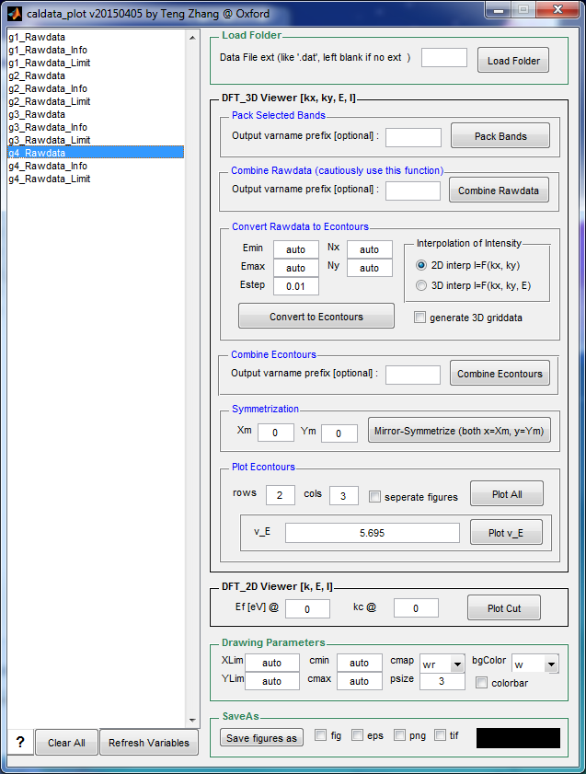
Quote from Teng
Do the same procedure for g1/g2/g3/g4

Slide 19
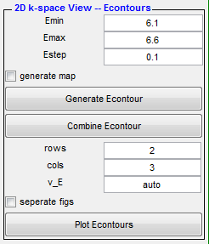
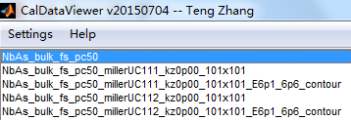
2D k-space View – Econtours Generate Contours
Generate a set of contours at energy [Emin: Estep: Emax]
contours for ‘resample plane’, ‘arbitrary cut’ and ‘surface’ data
Except ‘raw data’ and ‘resample bulk’ data (Matlab build-in function: ‘contour’ for 2D data, ‘isosurface’ for 3D data )
First select data to draw contour
Raw data
Cut UC111 data
Cut UC112 data
‘p’ replaces ‘.’

Slide 20
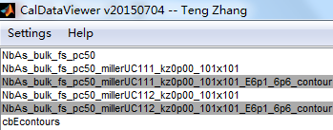
2D k-space View – Econtours Combine Contours
multi-select contours
Press <Combine Econtour>
Note:
contour energy range [Emin: Estep: Emax] must be same, or you can’t combine them
default output name is ‘cbEcontours’

Slide 21
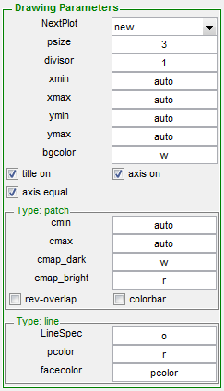
2D k-space View – Econtours Plot Contours
Only for ‘contour’ and ‘cdEcontours’ (see left)
Default v_E is [Emin: Estep: Emax]
Check off ‘separate figs’ to draw 2*3 contours in one fig, else draw one contour in one fig
Set drawing parameters in panel ‘Drawing Parameters’

Slide 22
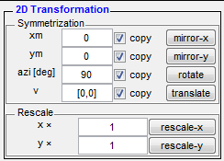
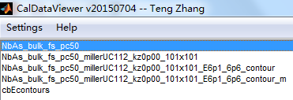
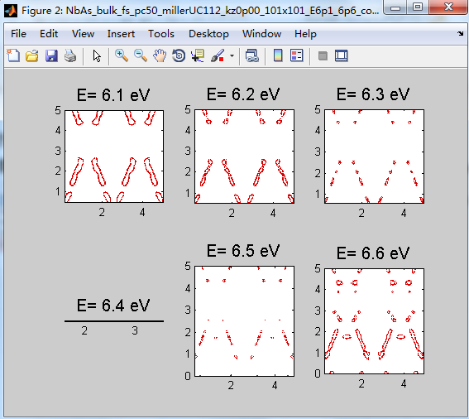
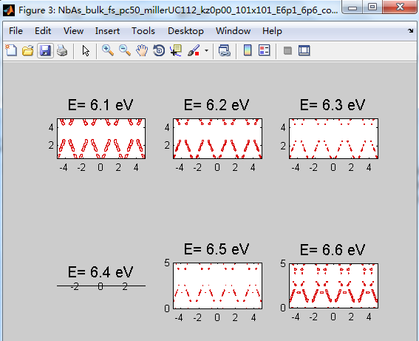
2D Transformation
Select 2D contour data (see left)
Press one transformation (right)
New data is ‘*_contour_m/R/a’
NbAs UC112
X=0 mirror

Slide 23
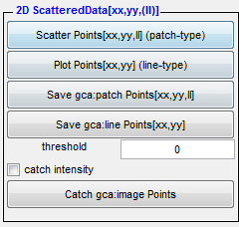
2D ScatteredData[xx,yy,(II)]
Plot 2D scattered data (patch type and line type)
Set drawing parameters in panel ‘Drawing Parameters’

